Slide 1

AMAZON ELECTRONICS
WEB SCRAPING
MAUL SRI M
DA/DS B5
08-04-2025

Slide 2
INTRODUCTION
Analyze Amazon electronics data to uncover product trends and customer preferences.
Collected 20,000+ products using BeautifulSoup, including name, price, rating, and reviews.
Cleaned data was pushed into a SQL database for structured access and analysis.
Covered EDA, clustering, classification, and model tuning for real-world insights.

Slide 3
WEBSCRAPING
Target Website: Amazon's Electronics category.
Tools Used:
requests for sending HTTP request
BeautifulSoup for parsing HTML content.
Scraping Logic:
Paginated through search results using a loop
Extracted product Name, Price, Rating, and Number of Reviews
Implemented error handling for missing data and network issues.

Slide 4
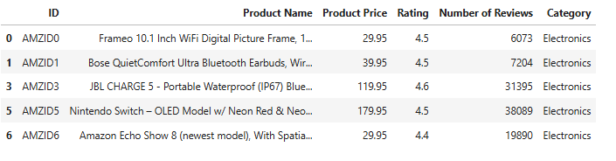
DATASET PREVIEW
Structured extraction of data elements from the webpage.
Size: Over 20,000 product entries collected.
Key Features : Product Name, Price, Rating, Reviews, Category.

Slide 5
DATA CLEANING
To ensure data uniqueness by removing 1679 duplicated rows .
Converted all features to proper numeric types.
Filled missing numeric values using median imputation
Detected and removed outliers to improve model accuracy.
Final cleaned dataset contains 15,303 rows.
SQLAlchemy was used to store and manage cleaned data.

Slide 6
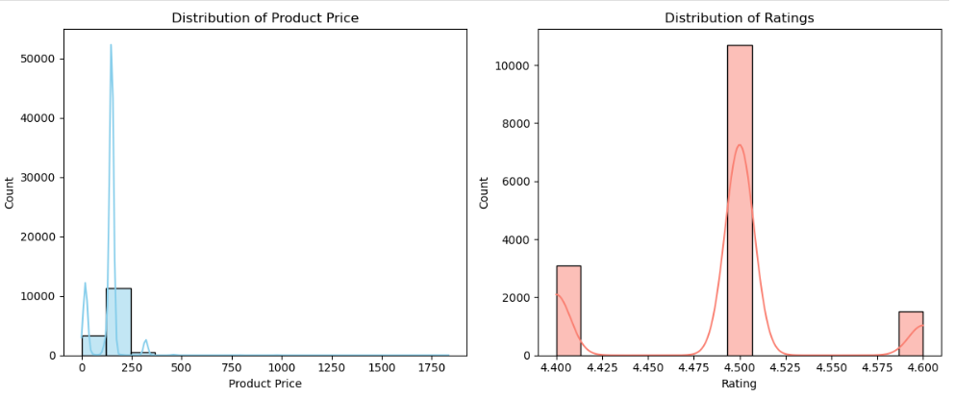
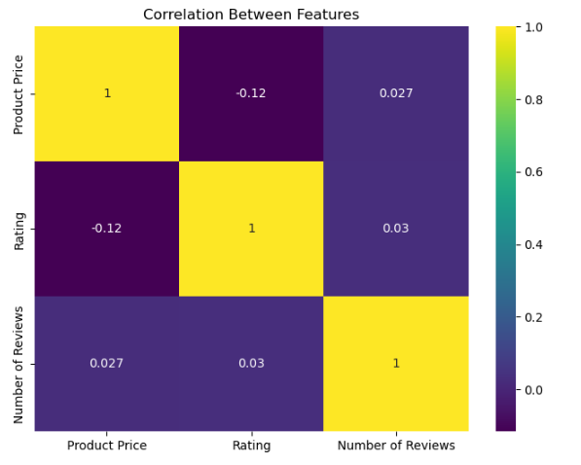
EDA

Slide 7
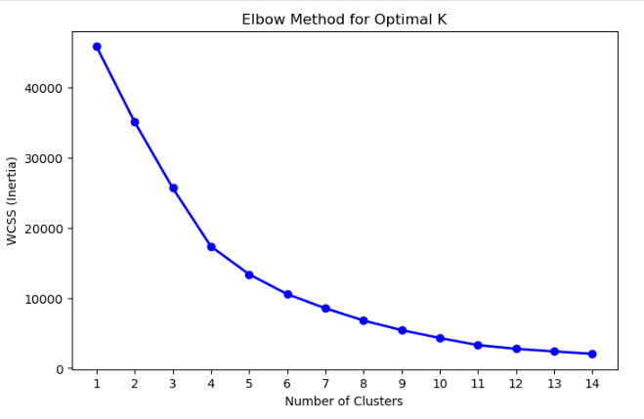

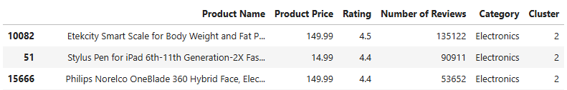
UNSUPERVISED LEARNING
Applied K-Means Clustering to group similar products.
Optimal number of clusters [k=4] selected using the elbow method.
Added a new ‘Cluster’ column to indicate each product's group.
Cluster 2 contains the most reviewed and likely most popular products

Slide 8
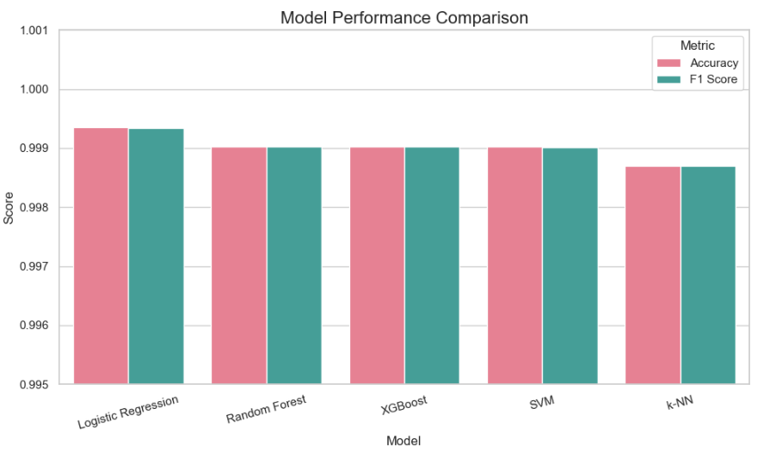
SUPERVISED LEARNING
Goal: Classify products into clusters based on features.
Features: Product Price, Rating, Reviews
Target: Cluster
Best Model: Logistic Regression
Accuracy: 99.93%
F1 Score: 0.9993
Logistics Regression outperformed all other models.

Slide 9
KEY INSIGHTS
The most in-demand product based on the number of reviews is “Etekcity Smart Scale for Body Weight and Fat Percentage”. with 135,122 reviews and a 4.5 rating.
Products in Cluster 2 contains most review indicating top-performing product.
Products in Cluster 3 yet maintain good ratings for cost-conscious customers.
Higher product ratings are positively correlated with the number of reviews suggesting customer satisfaction drives engagement and trust.

Slide 10
FUTURE STEPS
Expand Data Scope from multiple e-commerce platforms like
Flipkart, eBay, etc., for broader analysis.
Extract more features such as discount percentage and shipping options.
Experiment with advanced methods like DBSCAN or hierarchical clustering.
Deploy as a Web App to allow users to explore insights in real time.
Scrape customer reviews and apply NLP techniques to gauge customer satisfaction

Slide 11
CONCLUSION
A complete data science pipeline, from web scraping to machine learning modeling.
Clustering and classification helped uncover product patterns and predict categories with high accuracy.
Insights from the analysis can guide product strategy, pricing, and marketing decisions.
The approach is scalable and adaptable to other domains beyond electronics.

Slide 12

THANK YOU

